Slide 1


Exploring Customer Churn:
Patterns, prediction and prevention
By: Rajashree Hajare

Slide 2
PROJECT OUTLINE
SKYLINE COMM is a leading European telecommunications company est. six years ago with a mission to transform connectivity across the continent. The company operates an extensive LTE network with comprehensive coverage across all major regions, ensuring seamless connectivity for millions of customers.
Problem statement defined is curb churn of customers because it is more expensive to acquire a new customer than to keep your existing once leaving

Slide 3
BUSINESS CASE
Monitor churn rate over time
  Track percentage of customers who cancel subscription over time period
Analyse customer profile those who churn
  Identify the key attributes and customer behaviours that lead discontinuation of service
  Clustering based on these characteristics
Identify Key Features for Churn Predicted by the Model
  Determine the primary drivers of churn as identified by the predictive model.
  Understand likelihood of existing customers to churn.

Slide 4
DATA INFO
Demographics
  Gender
  Other: Senior citizen, partners, dependents
Services
  Phone lines: Multiple lines
  Internet services: Online security, backup, device protection, Tech support , Streaming movies , Streaming TV
Account type
  Tenure
  Contract type: monthly, 1-yr., 2-yr.
  Paperless billing
  Payment method : mailed check, electronic check, credit card (auto), bank transfer (auto)
Source: IBM Sample dataset

Slide 5
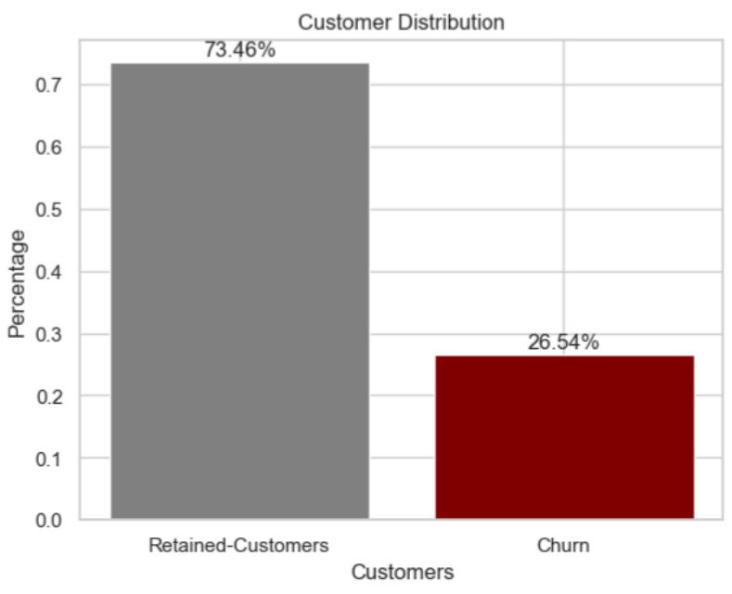
CHURN RATE
Focus area: 1
% of customers who cancel subscription
26.5% or nearly 1866 customers opted for other company services in span of 6 years

Slide 6
CUSTOMER PROFILE ANALYSIS
Focus area: 2
Demographics :
  Are singles : No partners (64.2%) and dependents (82.5)
Account information :
  Monthly contract (82%)
  opt paperless billing (74.9%) using electronic check (57.3%)
Usage Services :
  preferred Fibre optic type Internet service
  W/o online Tech support, backup and security, Streaming TV, streaming movies
Characteristics of customers who churn

Slide 7
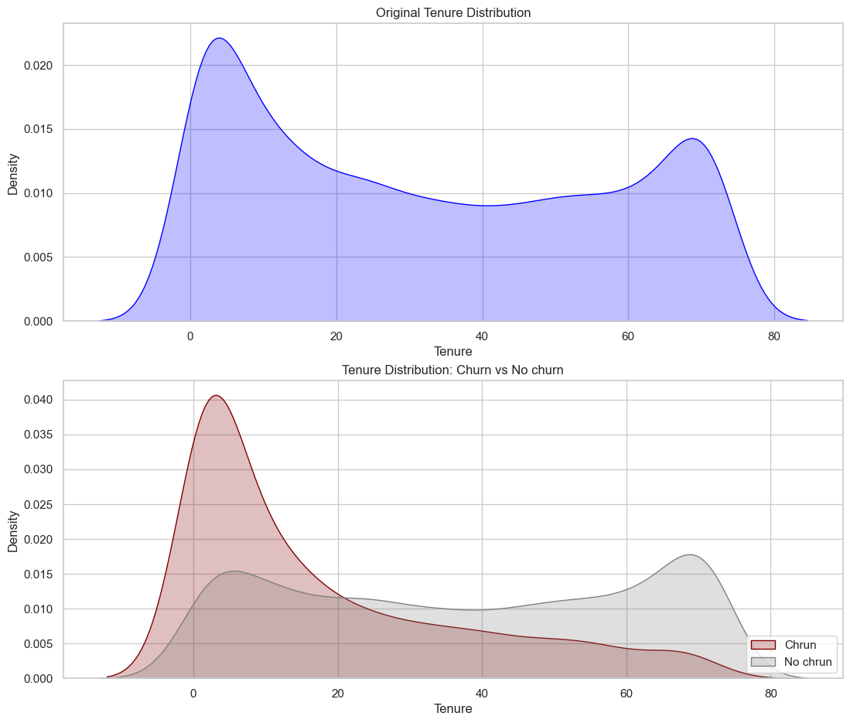
CUSTOMER PROFILE ANALYSIS
Tenure and Monthly charges distribution
Churn customers have mainly < 12 month contract

Slide 8
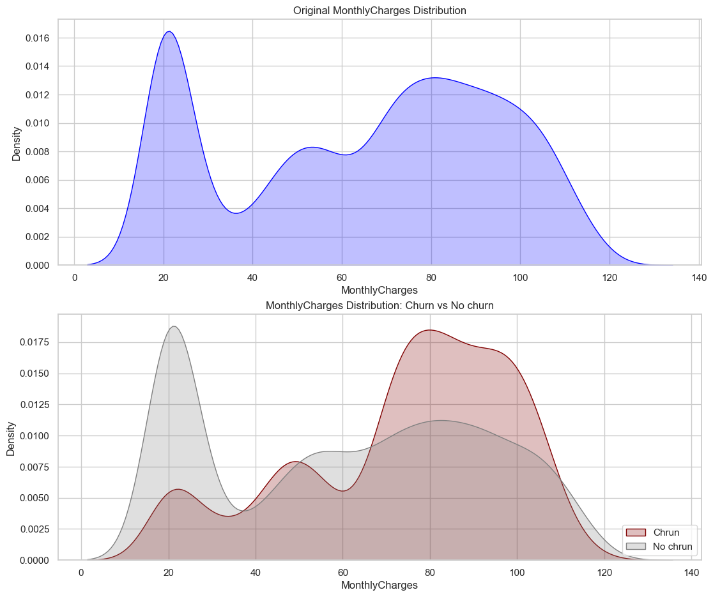
CUSTOMER PROFILE ANALYSIS
Tenure and Monthly charges distribution
Churn customers have monthly contract > $65 monthly

Slide 9
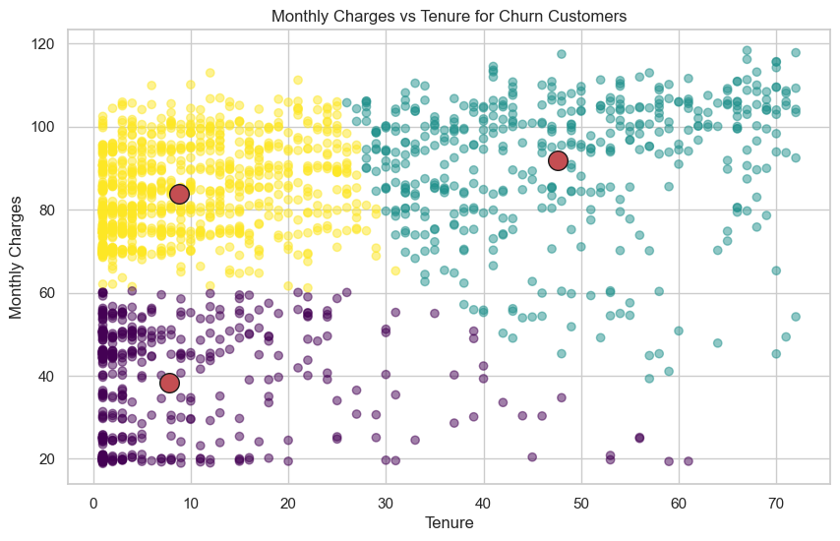
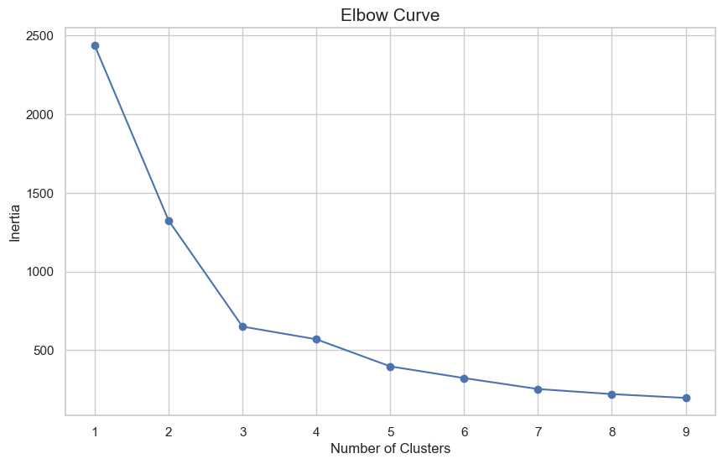
CLUSTERING
K-means clustering to cluster customers
Elbow method for ideal cluster determination
Low Tenure High Monthly charge
High Tenure High Monthly charge
Monthly charges vs Tenure over customer churn
Low Tenure Low Monthly charge

Slide 10
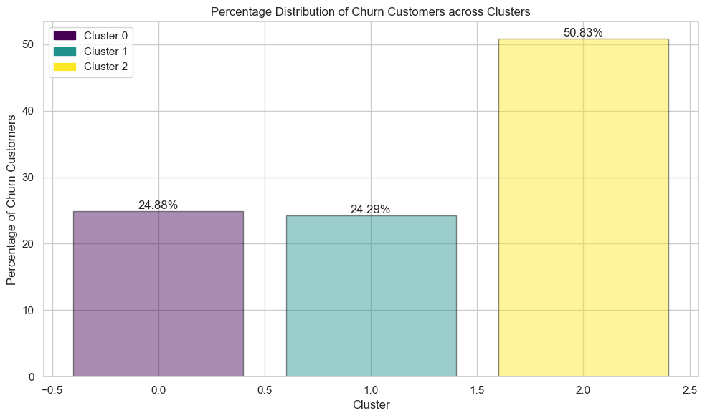
CLUSTERING
% of customers churn across clusters
Nearly 50% customer churn belong to low tenure and high montly charges group

Slide 11
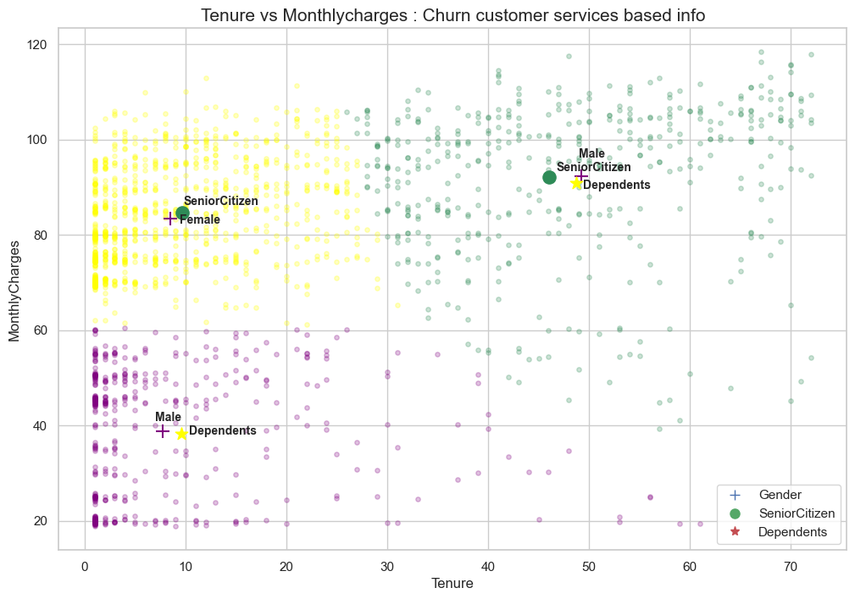
CLUSTERING
Low Tenure High Monthly charge
High Tenure High Monthly charge
based on demographics
Low Tenure Low Monthly charge

Slide 12
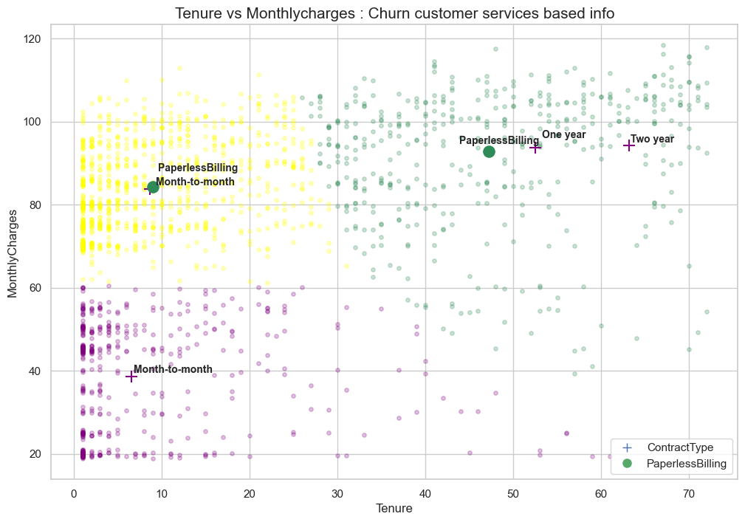
CLUSTERING
Low Tenure High Monthly charge
High Tenure High Monthly charge
based on account info
Low Tenure Low Monthly charge

Slide 13
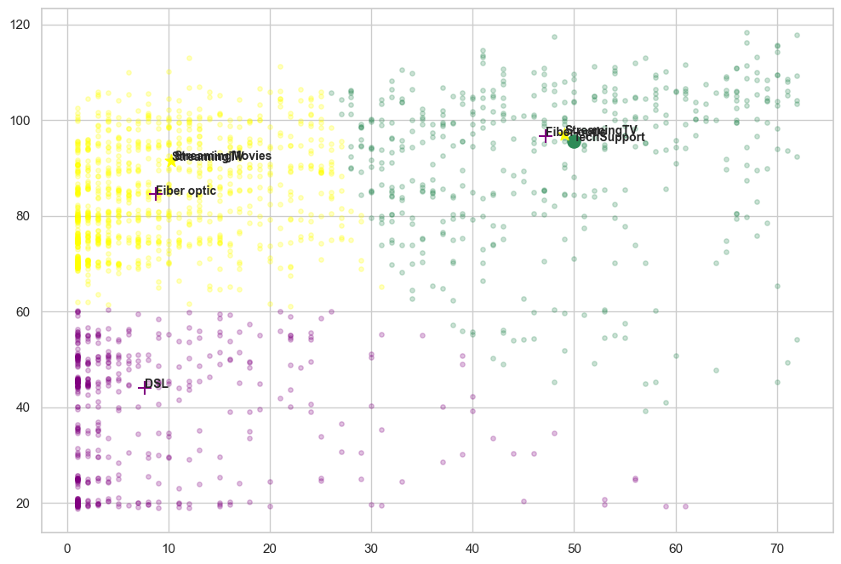
CLUSTERING
Low Tenure High Monthly charge
Low Tenure High Monthly charge
High Tenure High Monthly charge
High Tenure High Monthly charge
based on services
Low Tenure Low Monthly charge
Low Tenure Low Monthly charge

Slide 14
MODEL PREDICTION
Focus area: 3
CATEGORICAL DATA
Data preprocessing
  Train-test split
  Class imbalance
Model Selection
  Gradient boosting
  Logistic Regression
  KNN
  Random Forest
  ADAbooster
Identify key features

Slide 15
MODEL PREDICTION
Upon comparing the model performance:
  Random forest was the best method among the selected models with 74% accuracy (ROC AUC score: 0.743)
  After several tries with Grid search model, estimated optimal “depth” is 7, and “n-estimators” is 100.
Identify key features

Slide 16
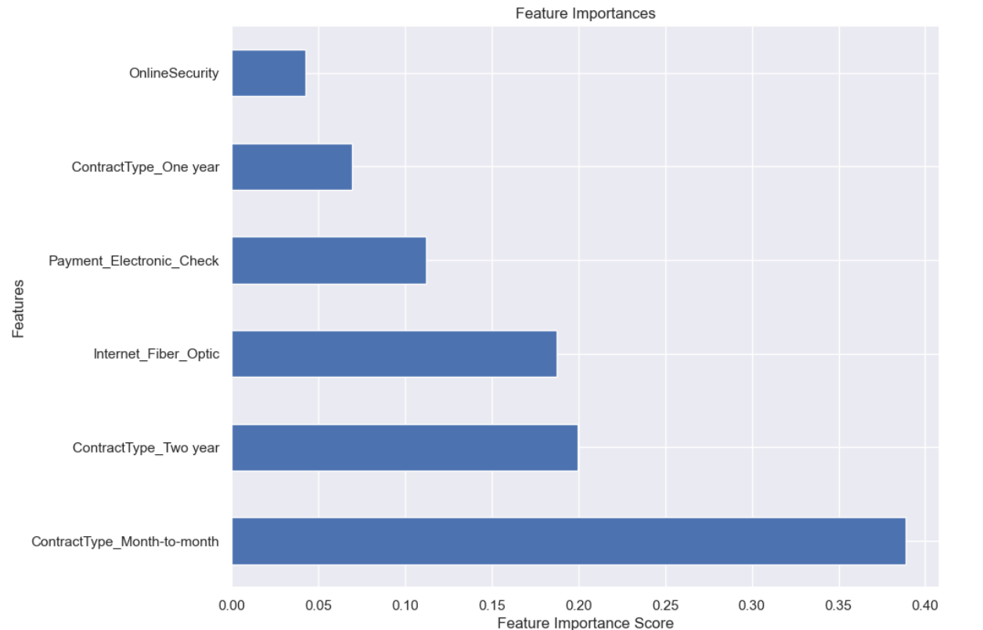
MODEL PREDICTION
Identify key features

Slide 17
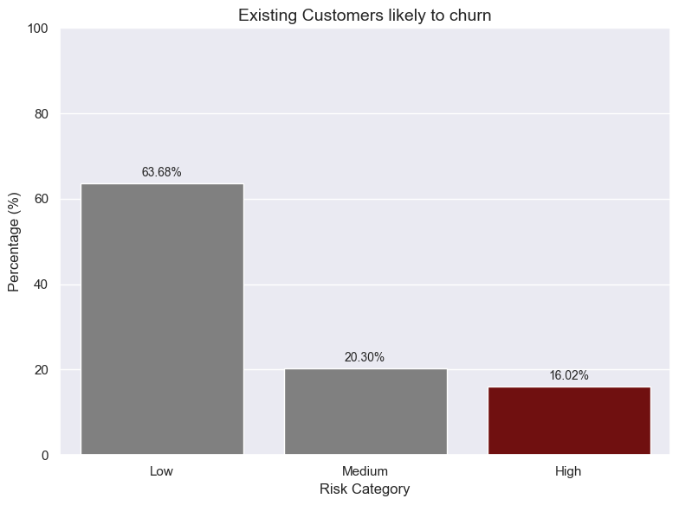
MODEL PREDICTION
Likelihood of existing customers to churn
  Focus strategies on retain 16% of existing customers from churn

Slide 18
CONCLUSION
Promote retention strategies
  Customise personalized plan for singles to enhance retention.
  Review pricing strategies to match perceived value for customers paying high monthly charges for low tenure period.
Focus on Service Enhancement
  Continuously improve optic fibre internet service reliability and speed.
  Ensure consistent service quality to meet customer expectations.
How can the company prevent customer churn in coming year

Slide 19
THANK YOU.

